Slide 1

Flipping pancakes problem (Decrease and conquer)

Slide 2
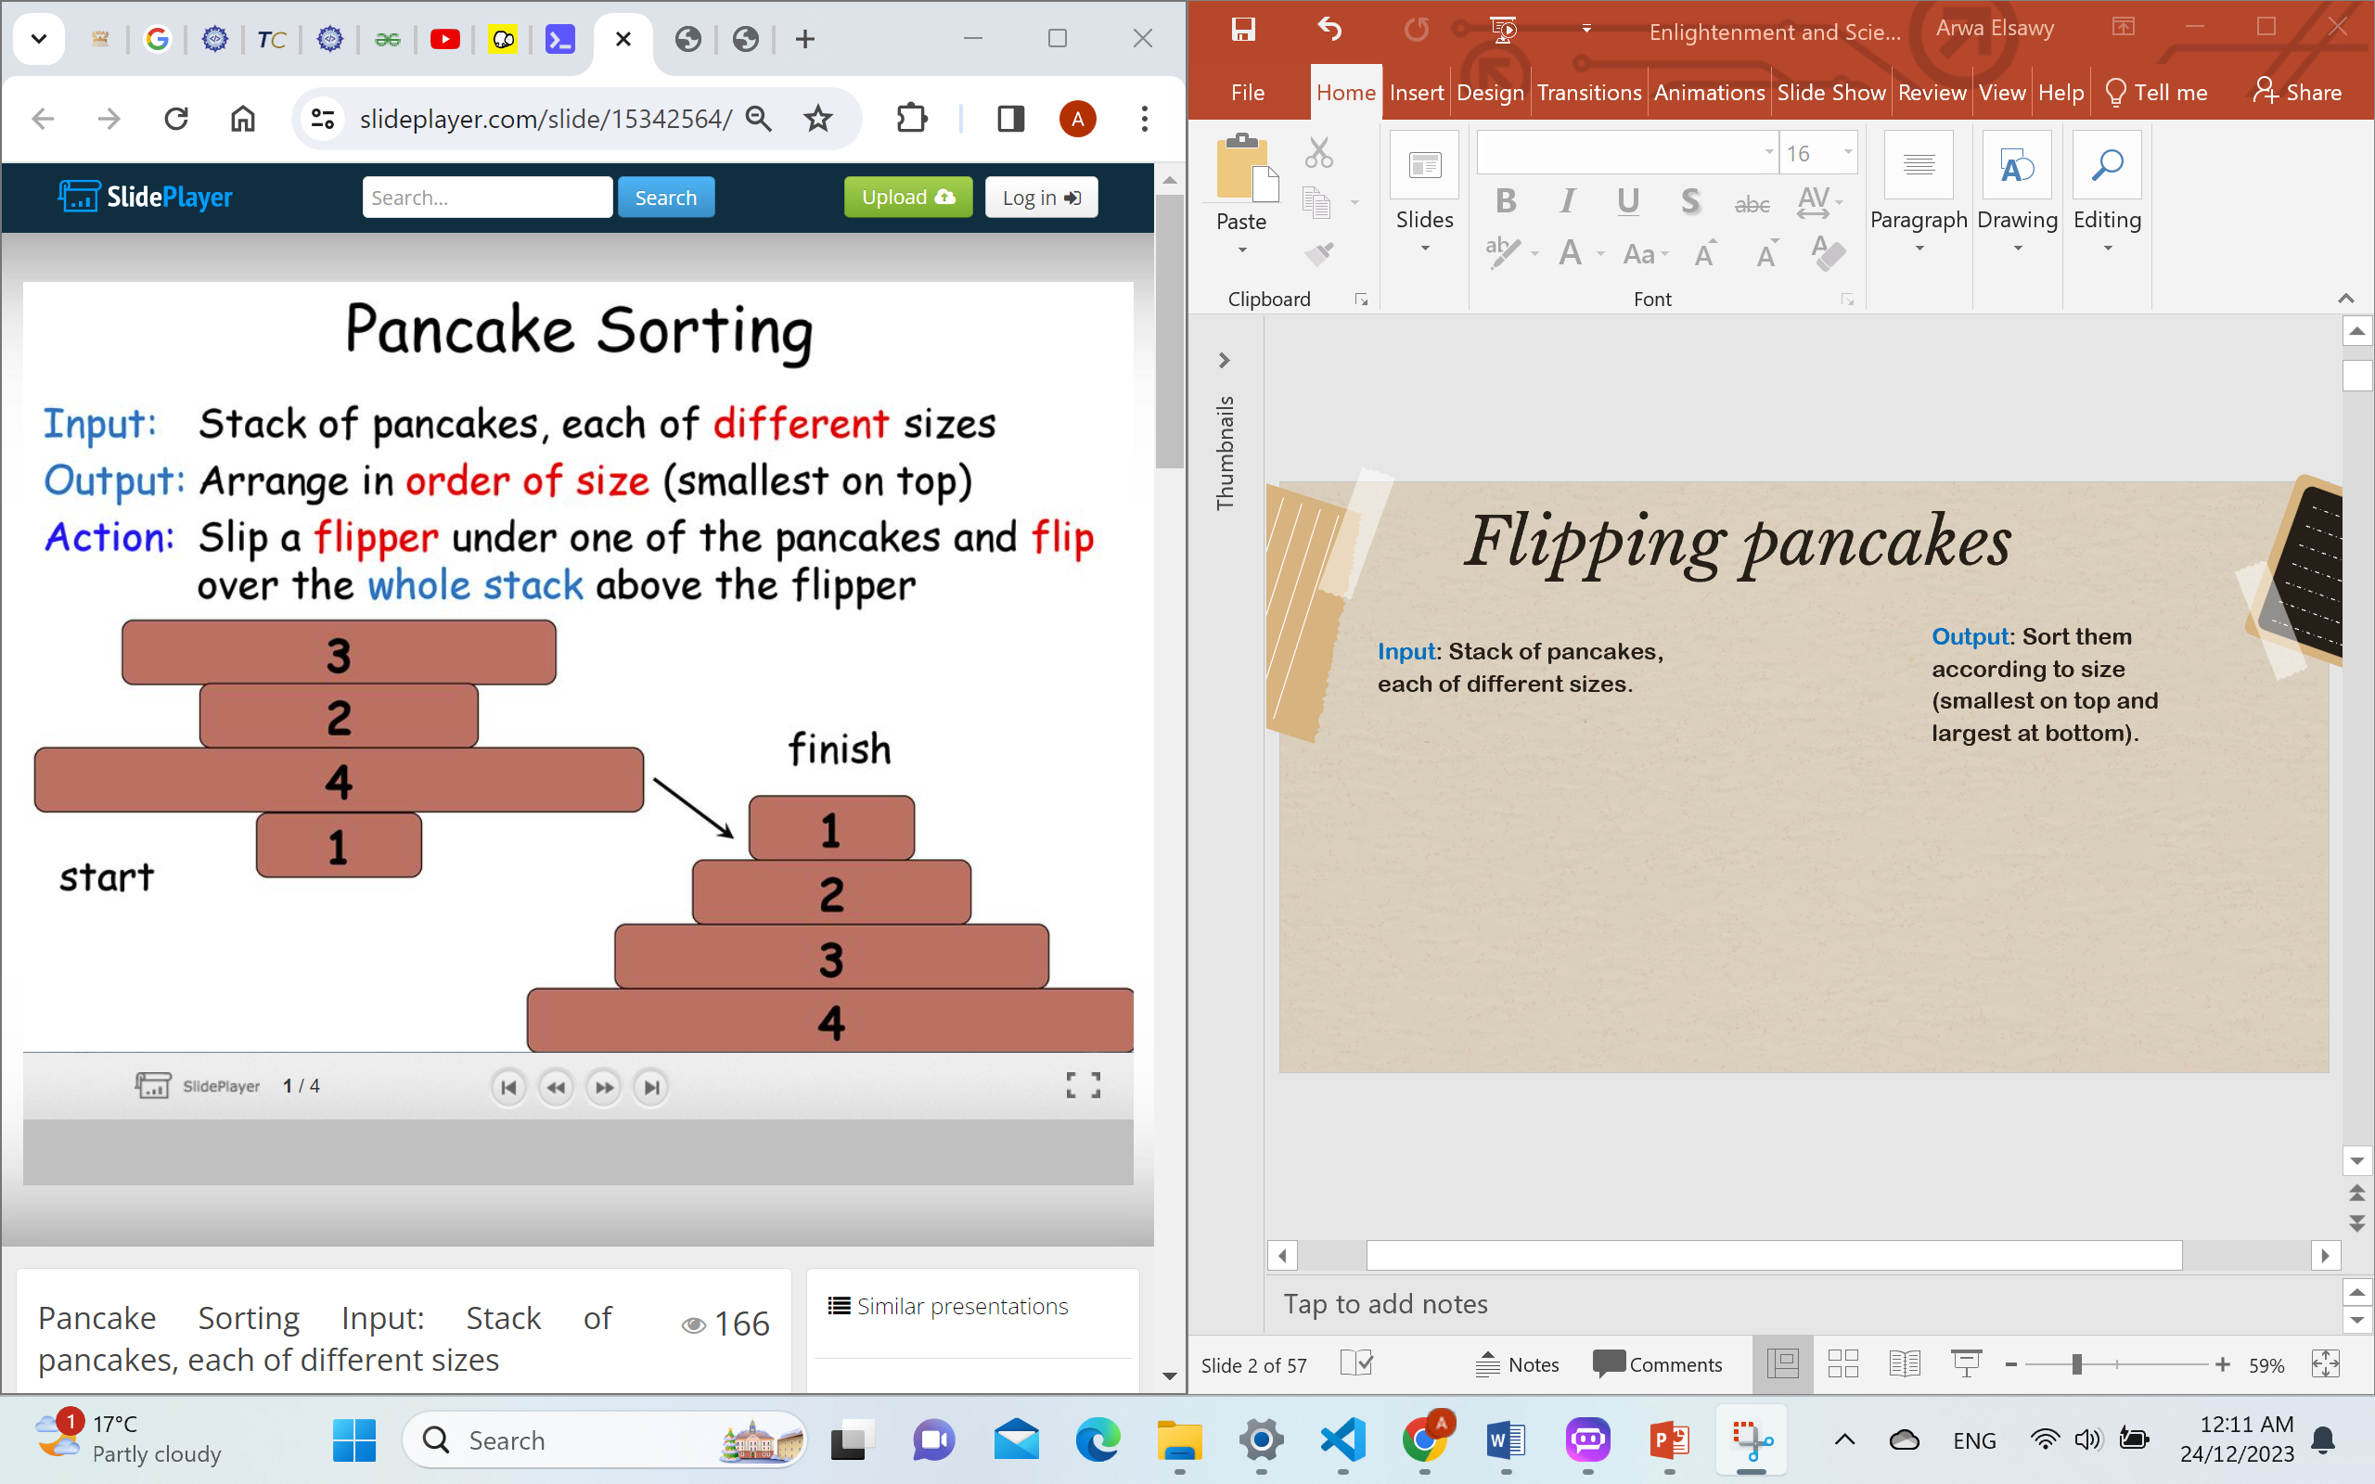
Flipping pancakes
Output: Sort them according to size (smallest on top and largest at bottom).
Input: Stack of pancakes, each of different sizes.
Finish
flip(arr, i)

Slide 3
Example
3
2
4
1

Slide 4
Flip 1
3
4
2
2
4
3
1
1

Slide 5
Flip 2
4
1
2
3
3
2
1
4

Slide 6
Flip 3
1
3
3
1
2
2
4
4

Slide 7
Flip 4
3
2
1
1
2
3
4
4

Slide 8
Flip 5
2
1
1
2
3
3
4
4

Slide 9
Suppose we have the array: (3, 5, 2, 1, 7, 6, 4,). We will sort it using the pancake sort algorithm,
and remember You are allowed to do only following operation on array. -> flip(arr, i): Reverse array from 0 to i
First flip : [3, 5, 2, 1, 7, 6, 4]
Fifth flip : [1, 2, 5, 3, 4, 6, 7]
after first flip : [7, 1, 2, 5, 3, 6, 4]
after fifth flip : [5, 2, 1, 3, 4, 6, 7]
Second flip : [7, 1, 2, 5, 3, 6, 4]
Sixth flip : [5, 2, 1, 3, 4, 6, 7]
after second flip : [4, 6, 3, 5, 2, 1, 7]
Third flip : [4, 6, 3, 5, 2, 1, 7]
after sixth flip : [4, 3, 1, 2, 5, 6, 7]
after third flip : [6, 4, 3, 5, 2, 1, 7]
Seventh flip : [4, 3, 1, 2, 5, 6, 7]
Fourth flip : [6, 4, 3, 5, 2, 1, 7]
after seventh flip : [2, 1, 3, 4, 5, 6, 7]
after fourth flip : [1, 2, 5, 3, 4, 6, 7]
Eight flip : [2, 1, 3, 4, 5, 6, 7]
after eighth flip : [1, 2, 3, 4, 5, 6, 7]

Slide 10
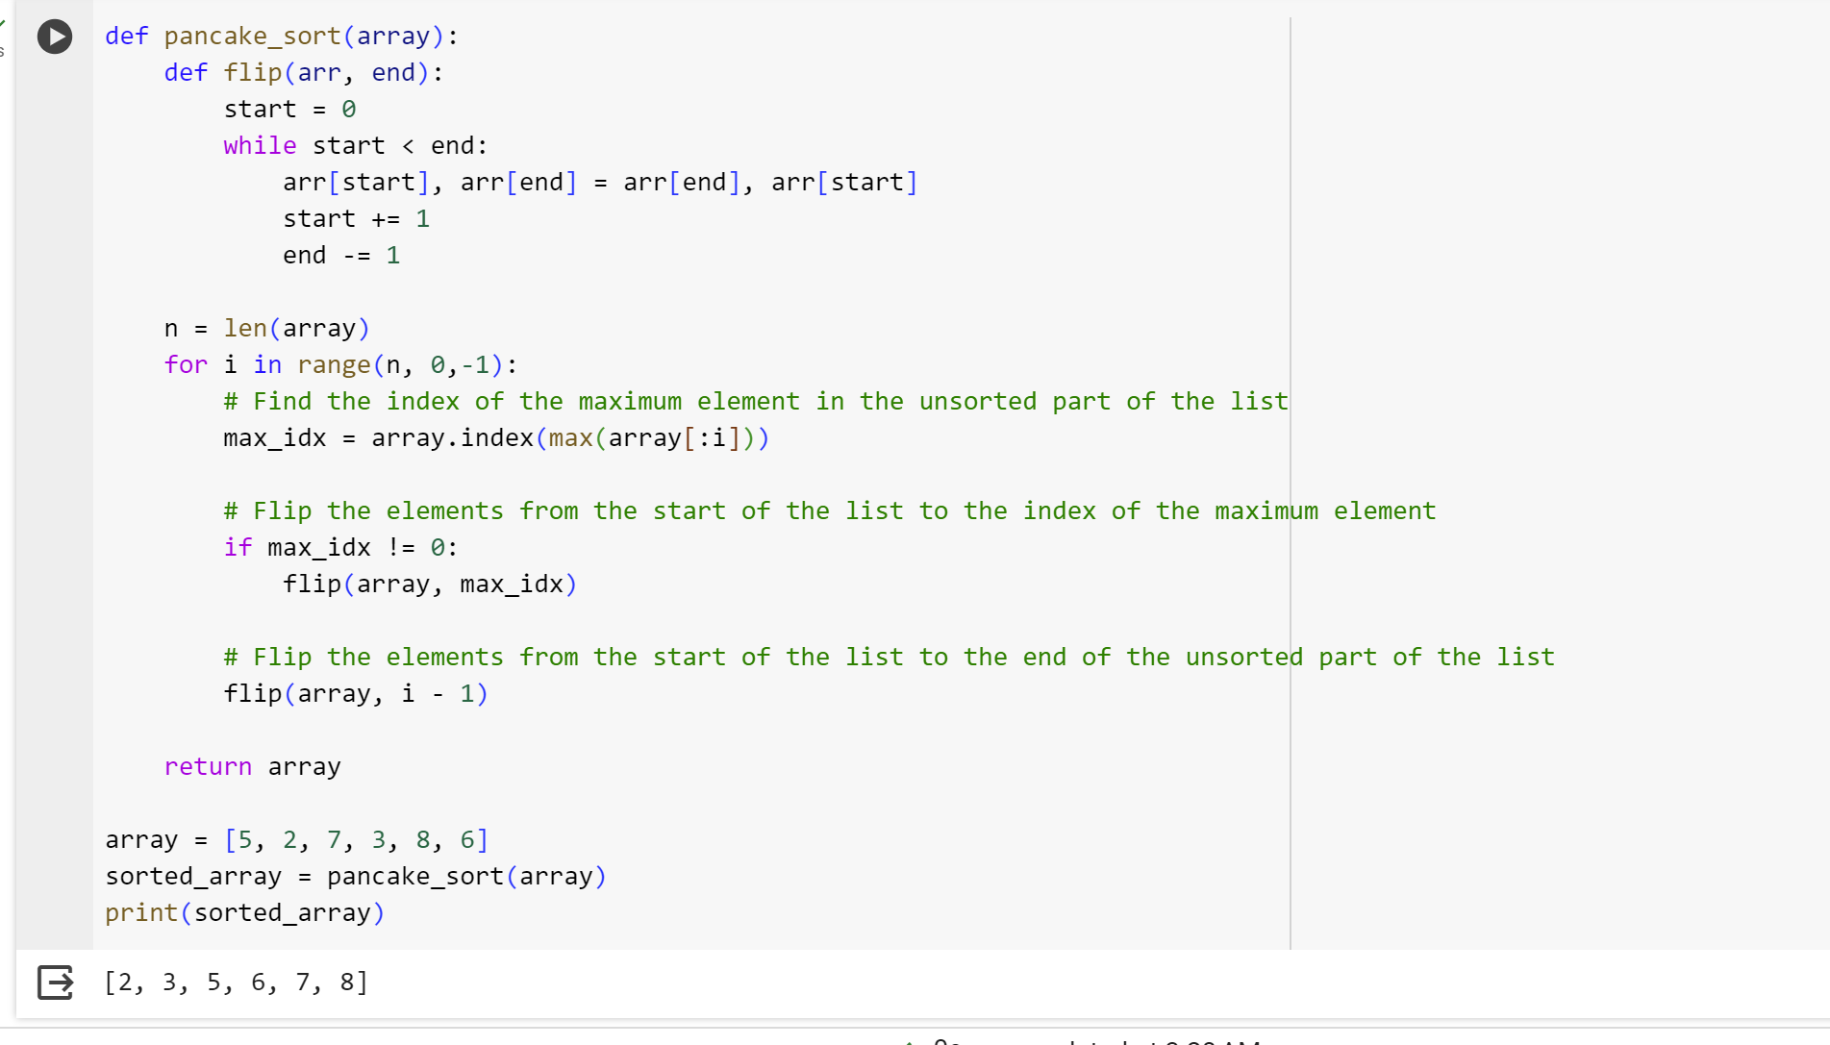
Pancake sorting algorithm implementation

Slide 11
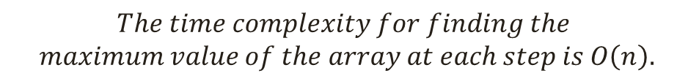

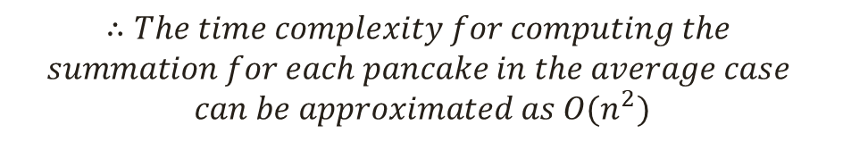
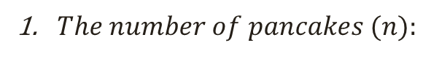

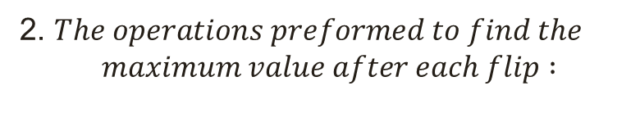
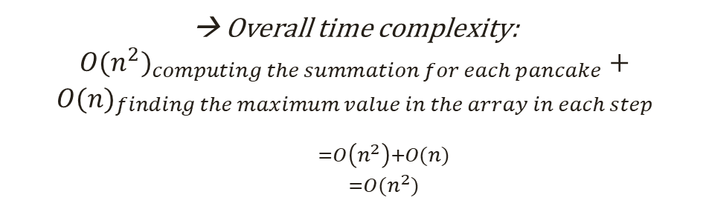

Slide 12
Thanks

